Slide 1


EOMP #3 PRESENTATION
Team: Imagineers
Customer: mrs.thao to
MENTOR: Mr.Hieu To

Slide 2

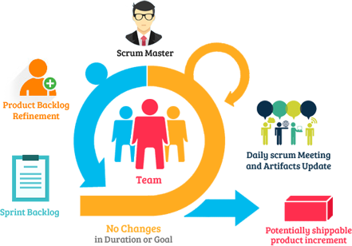

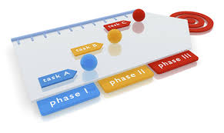
Objectives of the EOMP #3 Presentation
Notes:
Team formation
Development process establishing
Strategic and tactical project plan
Define basic assessment for risk management and product/system feasibility

Slide 3
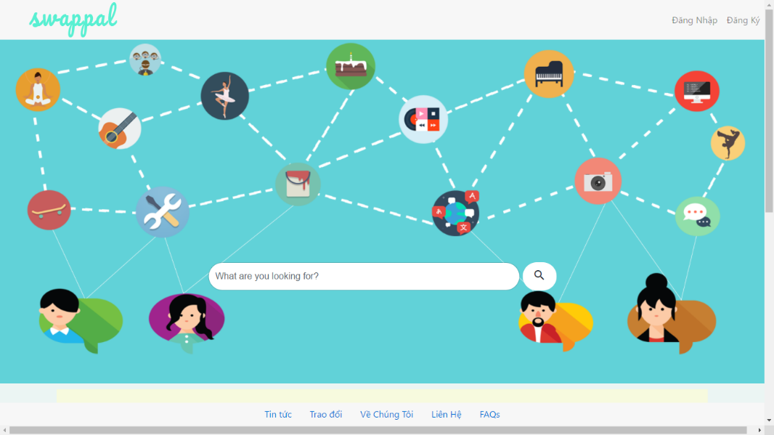

Objectives of the EOMP #3 Presentation
Notes:
Team formation
Development process establishing
Strategic and tactical project plan
Define basic assessment for risk management and product/system feasibility

Slide 4





Content
Project overview
Development process
Project Planning
Process Decision
Team formation
Project execution

Slide 5

Content
Reflection
Product demo

Slide 6
Project Overview
Part 1: Business background

Slide 7

Business background
Sharing & Learning
Without paying fee
Making relationship
Building trust
SHARING COMMUNITY
Notes:
Background: Nowadays, lots of people share and get information from each other.
We build community based on sharing new things( skills, services, goods) across the world

Slide 8
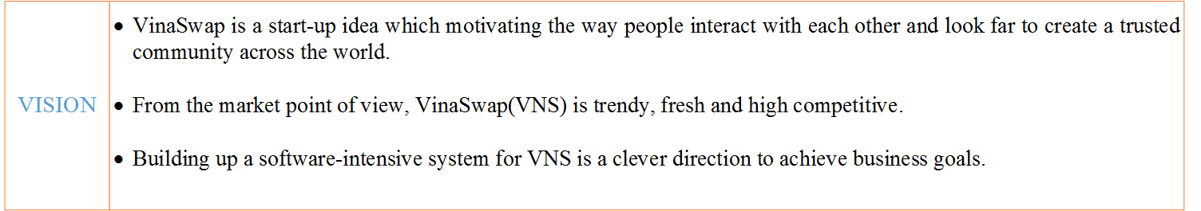
Product Vision
Notes:
VinaSwap’s SWOT
S(STRENGTHS)
- A surprise factor
- VINASWAP can be ahead in the business
- Free service for people
W(WEAKNESS)
- The business process vague
- It can be challenge to change user’s mind
- Lack of experiences
O(OPPORTUNITIES)
- Other business to marketing theirs
- Business opportunities are big
- VINASWAP could be the biggest Swap and Bartering site in Vietnam
- It can turn into a great social place
- Can build trust relationship and friendship
T(THREATs).
-Can be a threat due to trusting issues.
- Competitors like Cragslist...
- The cost to run the site and app can be a challenge

Slide 9
Project Overview
Part 1: Project Stakeholders

Slide 10
Project Stakeholders-Customer
CUSTOMER: MS. THAO TO | INFORMATION
FULL NAME | TO THI THU THAO
D.O.B | 18/06/1985
JOB | Freelance English tutor
ROLE IN PROJECT | CUSTOMER
CELLPHONE | 0909144022
EMAIL ADDRESS | yenthaoxhnv@gmail.com
SKYPE | Sunflower_vn1
HOBBIES | Traveling, hiking, and meeting new people
Notes:
VinaSwap’s SWOT
S(STRENGTHS)
- A surprise factor
- VINASWAP can be ahead in the business
- Free service for people
W(WEAKNESS)
- The business process vague
- It can be challenge to change user’s mind
- Lack of experiences
O(OPPORTUNITIES)
- Other business to marketing theirs
- Business opportunities are big
- VINASWAP could be the biggest Swap and Bartering site in Vietnam
- It can turn into a great social place
- Can build trust relationship and friendship
T(THREATs).
-Can be a threat due to trusting issues.
- Competitors like Cragslist...
- The cost to run the site and app can be a challenge

Slide 11
Project Stakeholders-Mentor
MENTOR: MR. HIEU TO | INFORMATION
FULL NAME | TO DINH HIEU
JOB | CMU Lecturer
ROLE IN PROJECT | Mentor
EMAIL ADDRESS | todinhhieu@vanlanguni.edu.vn
Notes:
VinaSwap’s SWOT
S(STRENGTHS)
- A surprise factor
- VINASWAP can be ahead in the business
- Free service for people
W(WEAKNESS)
- The business process vague
- It can be challenge to change user’s mind
- Lack of experiences
O(OPPORTUNITIES)
- Other business to marketing theirs
- Business opportunities are big
- VINASWAP could be the biggest Swap and Bartering site in Vietnam
- It can turn into a great social place
- Can build trust relationship and friendship
T(THREATs).
-Can be a threat due to trusting issues.
- Competitors like Cragslist...
- The cost to run the site and app can be a challenge

Slide 12
Project Stakeholders-Development Team
TEAM: IMAGINEERS | INFORMATION
FULL NAME | IMAGINEERS
ROLE IN PROJECT | Development Team
EMAIL ADDRESS (of prepesentative) | b.thach511@gmail.com
Notes:
VinaSwap’s SWOT
S(STRENGTHS)
- A surprise factor
- VINASWAP can be ahead in the business
- Free service for people
W(WEAKNESS)
- The business process vague
- It can be challenge to change user’s mind
- Lack of experiences
O(OPPORTUNITIES)
- Other business to marketing theirs
- Business opportunities are big
- VINASWAP could be the biggest Swap and Bartering site in Vietnam
- It can turn into a great social place
- Can build trust relationship and friendship
T(THREATs).
-Can be a threat due to trusting issues.
- Competitors like Cragslist...
- The cost to run the site and app can be a challenge

Slide 13
Product / System feasibility
Part 1: SWOT

Slide 14

Product / System feasibility - SWOT
Strengths
Weakness
Oppotunities
Threats
Notes:
VinaSwap’s SWOT
S(STRENGTHS)
- A surprise factor
- VINASWAP can be ahead in the business
- Free service for people
W(WEAKNESS)
- The business process vague
- It can be challenge to change user’s mind
- Lack of experiences
O(OPPORTUNITIES)
- Other business to marketing theirs
- Business opportunities are big
- VINASWAP could be the biggest Swap and Bartering site in Vietnam
- It can turn into a great social place
- Can build trust relationship and friendship
T(THREATs).
-Can be a threat due to trusting issues.
- Competitors like Cragslist...
- The cost to run the site and app can be a challenge

Slide 15
Product / System feasibility
Part 2: Business Model

Slide 16

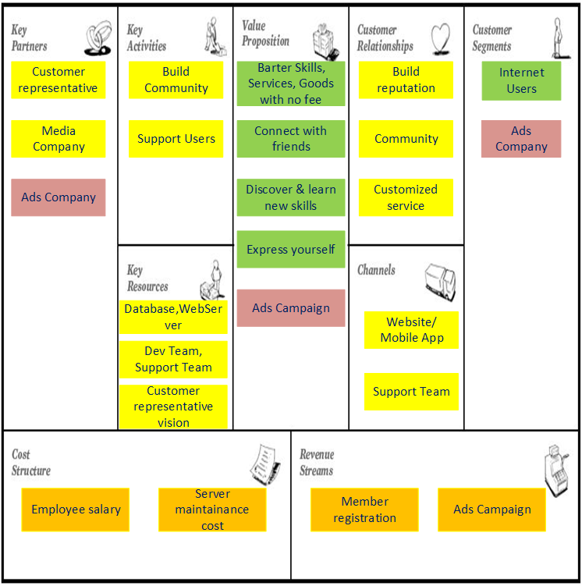
Product / System feasibility - Business model
Notes:
business model canvas

Slide 17
Project Overview
Part 2: Project description

Slide 18
Project description
Build a community site to help Vinaswap members swap and barter skills directly without paying any fees
Duration: 30 weeks
Expected Start date: 3/10/2016 –End: 29/05/2017
The system is developed in Web-based application

Slide 19
Team Introduction
Part 1: Team member

Slide 20

Team Intro - Team Name & Logo
IMAGINATIVE
ENGINEERS

Slide 21
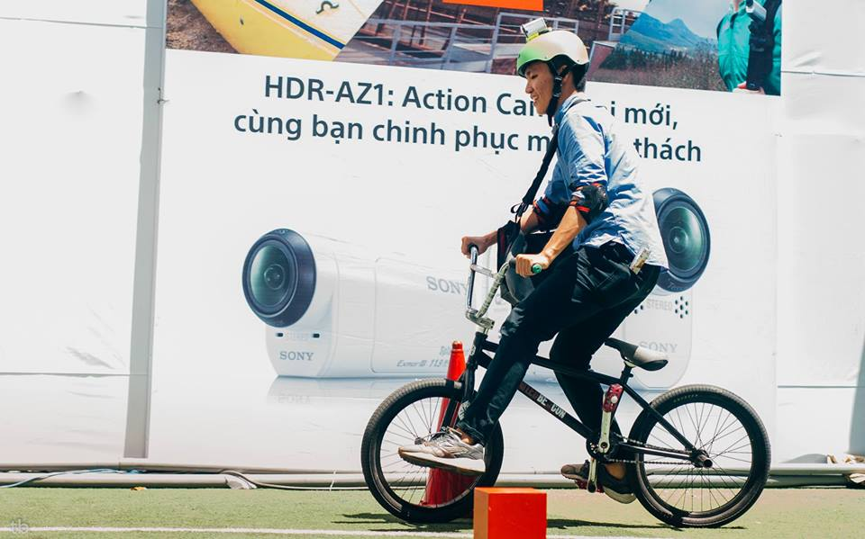
Team Intro - Team Members
FULL NAME: NGUYEN BAO THACH
PHONE: 0906. 729 567
EMAIL: b.thach511@gmail.com
SKYPE: b.thach511@gmail.com
Scrum master
Leader
Thach Nguyen
Notes:
Background: Nowadays, lots of people share and get information from each other.
We build community based on sharing new things across the world

Slide 22

Team Intro - Team Members
FULL NAME: NGUYEN HOANG NAM PHUONG
PHONE: 0128. 573 93 98
EMAIL: nguyenhoangnamphuong2110@gmail.com
SKYPE: nam_phuong1994
Product owner
Phuong Nguyen
Notes:
Background: Nowadays, lots of people share and get information from each other.
We build community based on sharing new things across the world

Slide 23
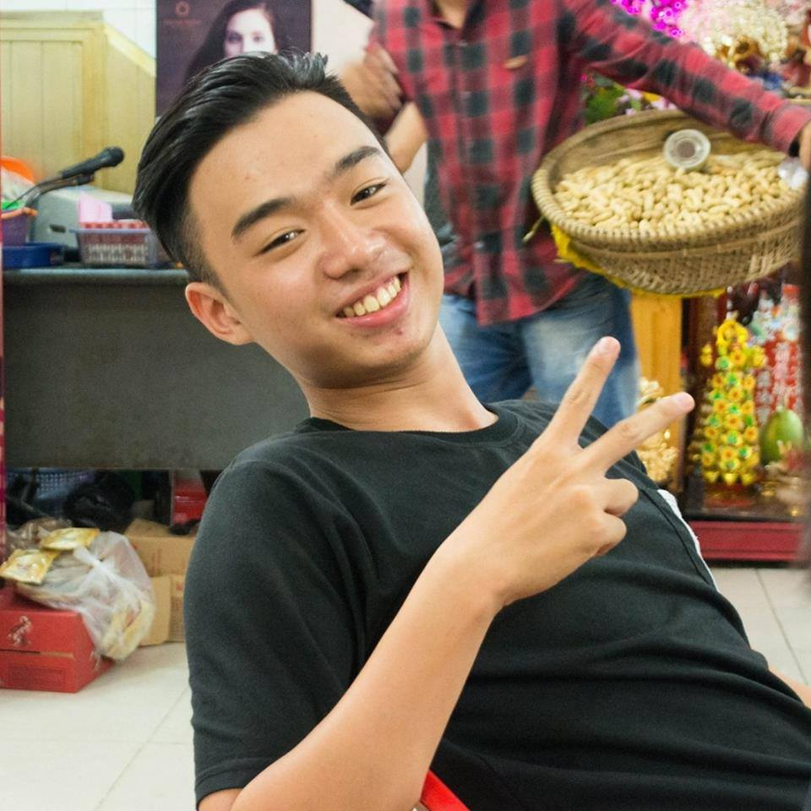
Team Intro - Team Members
FULL NAME: NGUYEN DANG QUANG
PHONE: 090. 305 4493
EMAIL: ndq.quang511@gmail.com
SKYPE: quang_nguyen73
Scrum Team Member
Quang Nguyen
Notes:
Background: Nowadays, lots of people share and get information from each other.
We build community based on sharing new things across the world

Slide 24
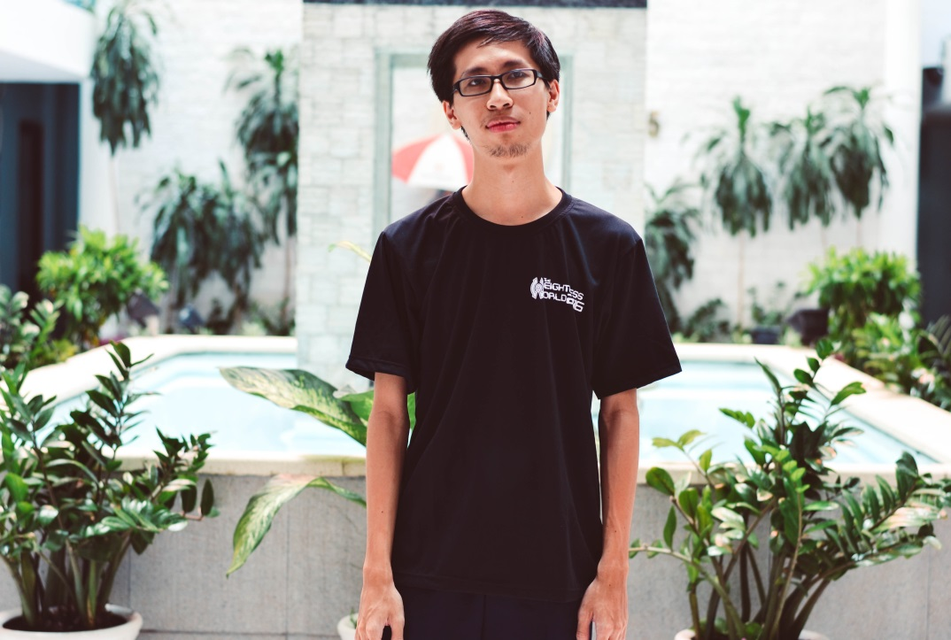
Team Intro - Team Members
FULL NAME: TRAN PHAN TRUNG CHANH
PHONE: 0122. 703 4475
EMAIL: hunteratthenight@gmail.com
SKYPE: zodiark1412
Scrum Team Member
Chanh Tran
Notes:
Background: Nowadays, lots of people share and get information from each other.
We build community based on sharing new things across the world

Slide 25
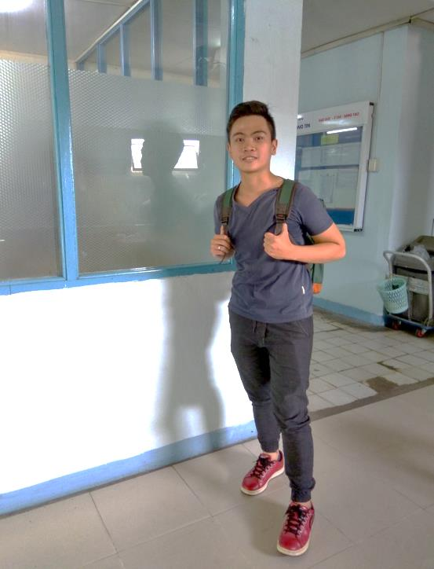
Team Intro - Team Members
FULL NAME: DANG QUOC VIET
PHONE: 0937. 461 963
EMAIL: vietdang.2509@gmail.com
SKYPE: viet.2509
Scrum Team Member
Viet Dang
Notes:
Background: Nowadays, lots of people share and get information from each other.
We build community based on sharing new things across the world

Slide 26
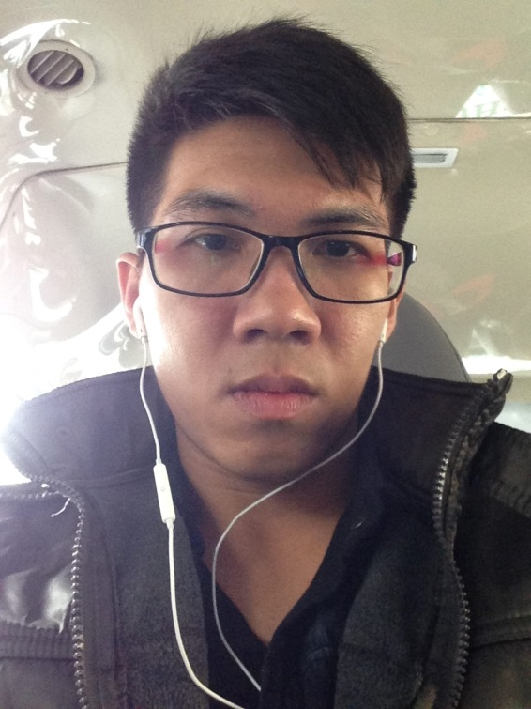
Team Intro - Team Members
FULL NAME: NGUYEN HUU TAI
PHONE: 0125. 434 5446
EMAIL: nguyenhuutai1995k19t01@gmail.com
SKYPE: huutai1995
Scrum Team Member
Tai Nguyen
Notes:
Background: Nowadays, lots of people share and get information from each other.
We build community based on sharing new things across the world

Slide 27
Development process
Part 1: Process decision

Slide 28
Development process - Decision

Slide 29
Development process
Part 2: Team formation

Slide 30
Team Formation - Main Purposes
Deliver high quality product to customer by the end of project
Build up customer retention with team for future project
Notes:
S.M.A.R.T GOALS:

Slide 31
Team Formation - Team Goals
Meet 80% of customer satisfaction (see more in Imagineers-MeasurementPlan)
Get 70% of positive feedbacks from product increment review
Ship product increment on time (no late than 10% of time-box)
Notes:
S.M.A.R.T GOALS:

Slide 32




Team Formation - Team Policy
Notes:
Team Policy
Commitment
Communication
Reward
Succeed
Team Communication

Slide 33
Team Formation - Team Working Time
COMMITMENT | WORKWEEK | PLACE | DURATION
ALL members have to work for 30hrs/week 8 hours/ day Mon→Sat Sunday is day-off | Mon → Sat: daily Scrum meeting | Floor 7th | 15 mins
 | Monday: Mentor meeting | Room 701C | 1-1.5 hrs Start 13h30PM
 | Sat: Sprint review Sprint retrospective | Room 701C | 1-1.5 hrs Start 13h30PM
 | Tuesday: Team meeting | Room 701C | 1-1.5 hrs Start 13h30PM
Notes:
More information in team communication

Slide 34
Development process
Part 1: Defined Scrum framework

Slide 35
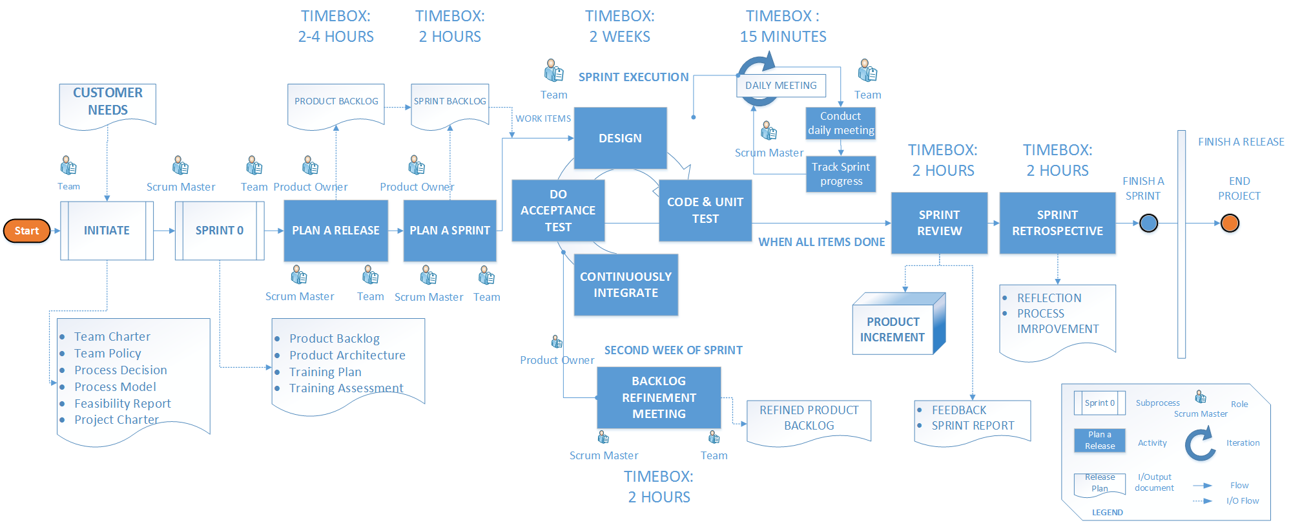
SCRUM PROCESS

Slide 36
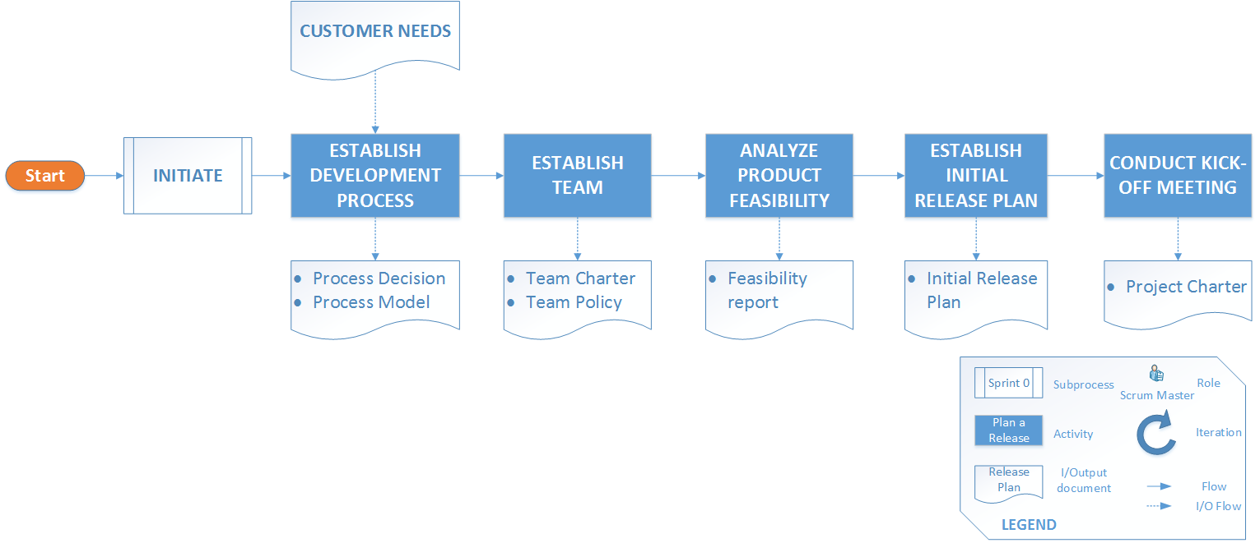
INITIATE SUB PROCESS

Slide 37
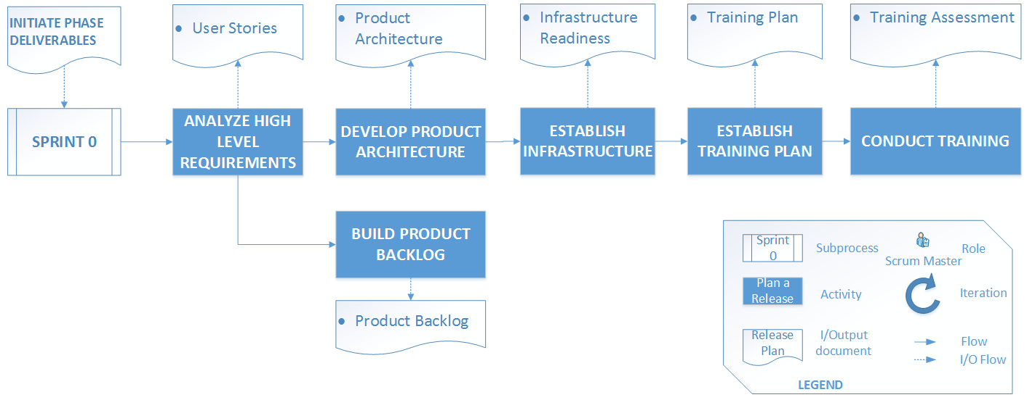
SPRINT 0 SUB PROCESS

Slide 38
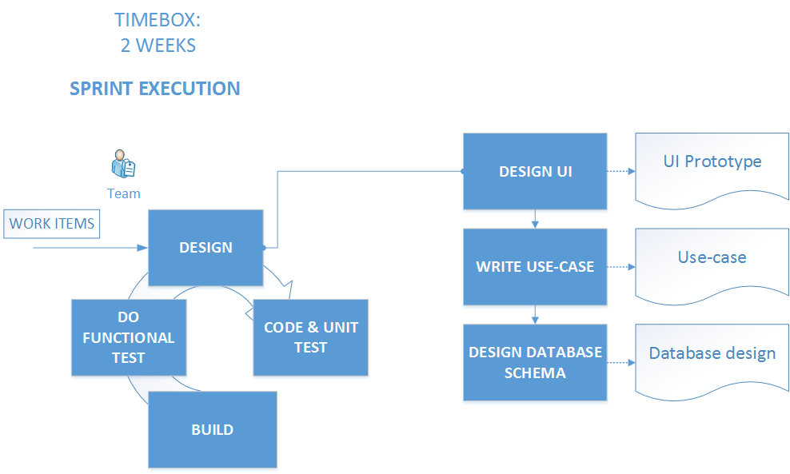
SCRUM EXECUTION

Slide 39
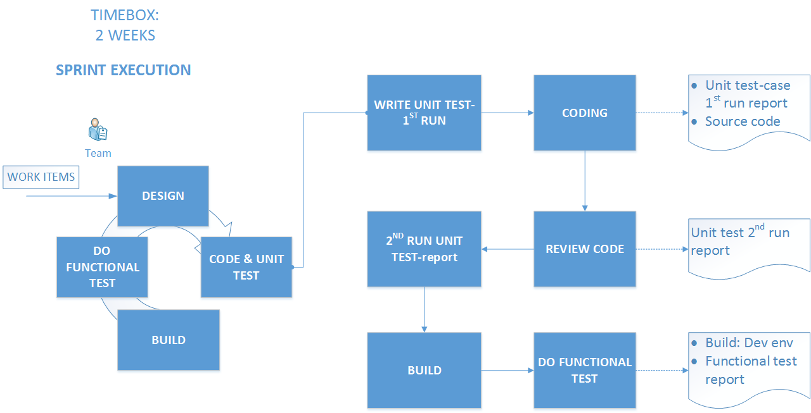
SCRUM EXECUTION (cont’)

Slide 40
Project Planning
Part 1: Milestone

Slide 41
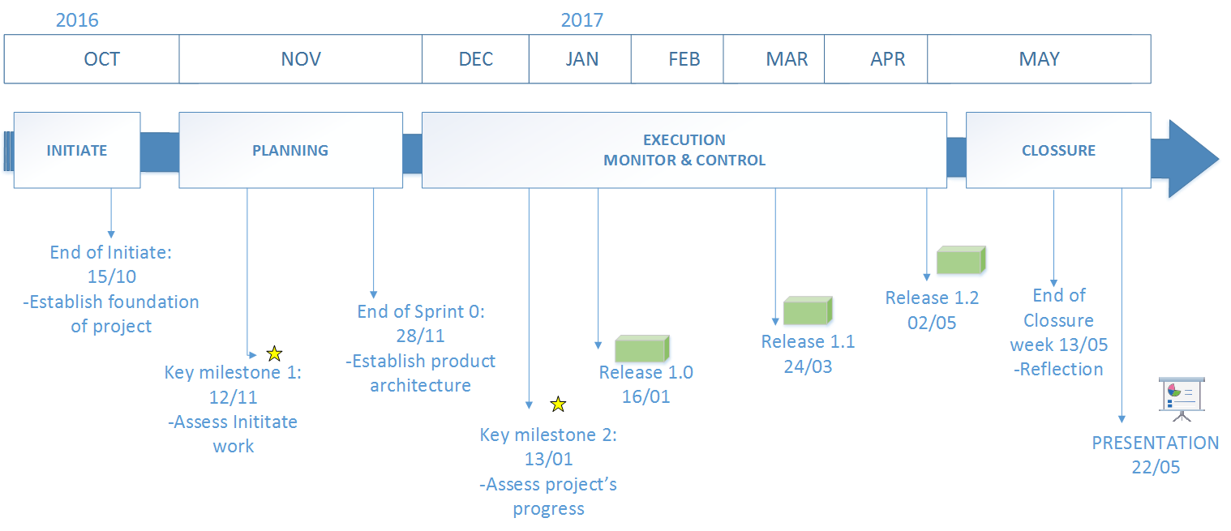
Project Planning- Milestone (old)
Status date
Notes:
Milestone

Slide 42
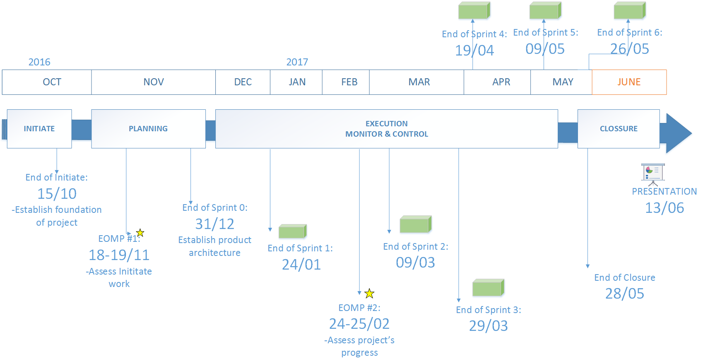
Project Planning- Milestone (updated)
Status date
Notes:
Milestone

Slide 43
Project Planning
Part 2: High-level Planning

Slide 44
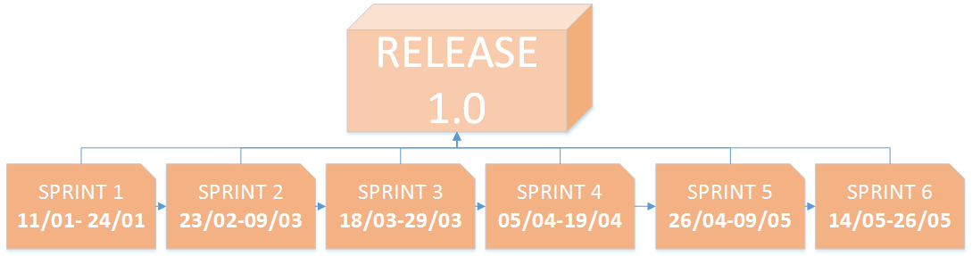
Project Planning- High level Planning (updated)

Slide 45
Product development stage
Part 1.0: Context/High level requirement

Slide 46
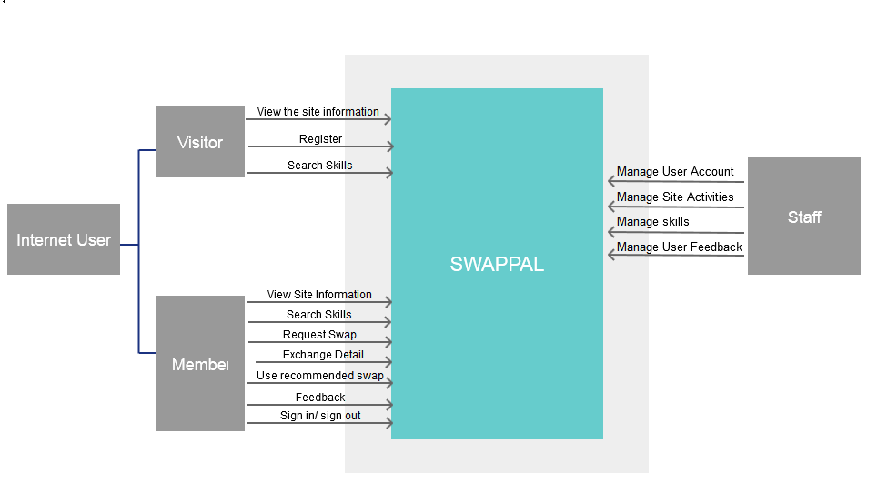
Context/High level Requirement-Scope

Slide 47
Product development stage
Part 2.0: Architecture drivers

Slide 48
Architecture drivers
6 Quality Attributes
31 Funtional Requirements
4 Constraints
1 Business/ 3 Technical

Slide 49
Product development stage
Part 2.1: Architecture rationale & decision

Slide 50
Architecture rationale
ID | Name | Concern | Description
 | Usability | User friendly GUI | Easy for different type of users to use the site Responsiveness
 | Performance | Response time | Load page from 3-5s Return html page to user from 3-5s
 |  | User throughput | Handle multiple user use site at a time(2000 per time)
 | Availability | Server uptime | Uptime 99,9%
 | Security | User information: account encrypted | Encrypted user account from hacker
 | Scalability | Scale out | Server growth in future
 | Testability | Can perform testing | Unit testing Load testing Performance testing

Slide 51
Architecture decision
ID | Name | Description
 | Using web app Satisfy -TC3-Accessible from browser -Feature: Staff manage Account, View report site activities -QA: Testing | Cost effective: Access system via web browser. Test on 1 operating system can fulfill the rest Accessible anywhere: via Internet connection(require) Easily customizable: user interfaces of web application is easier to customize than the desktop application( Related to concern Look and feel of GUI) Accessbile for a range of devices: inc. mobile phones, PCs.. extending ability to receive and interact with information Easier installation and maintainance: once a new version or upgrade is installed on the host server, all users can access it straight away

Slide 52
Architecture decision (cont’)
 | Using tier | 3-tier Client-Web Server-Database server Client uses Internet browser to access to rendered UI(HTML page) Server hosted from paid provider( Cloud VPS)
 | Using Virtual Private server(VPS) | VPS can be more secure than hosting service, with is provided by 3rd party. Can config on server Ability to apply some security: from DDOS,malware** Price is cheaper than physical server
 | Using divided server: each server has intended purpose to serve better | Separate server handle better Web server for handle request, load balancing(software Nginx), send back the requested page Database server handle query, store data collection
 | Using NoSQL database-Mongo Satisfy: -TC1:Platform -Performance: throughput, response time -Swapping, matching Searching skills | Mongodb is recommended, store data collection help query faster

Slide 53
Product development stage
Part 2.2: Architecture views

Slide 54
Architecture views-Physical

Slide 55
Architecture views-Dynamic
To be updated

Slide 56
Architecture views-Static
To be updated

Slide 57
Product development stage
Part 3.0: Product backlog

Slide 58
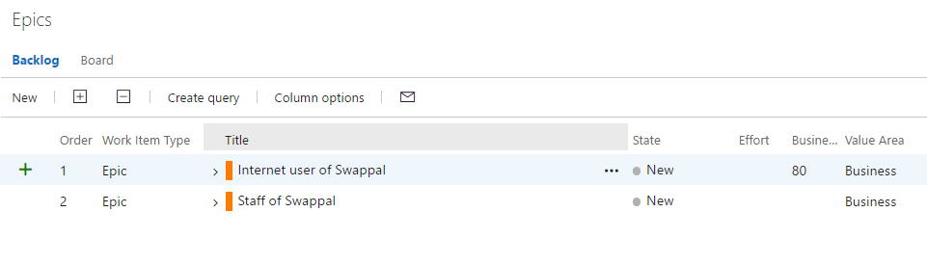
Product backlog-Epics

Slide 59
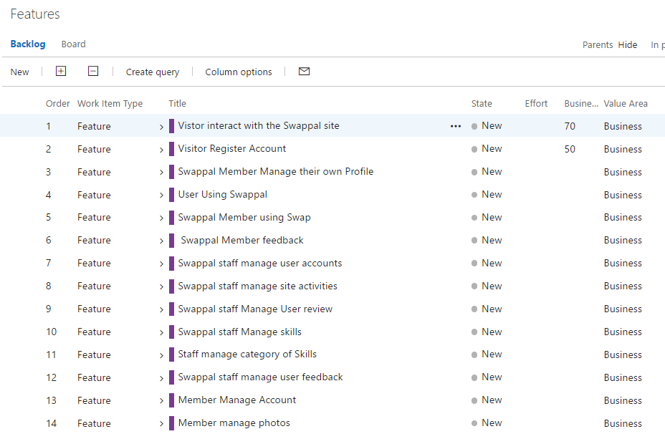
Product backlog-Feature

Slide 60
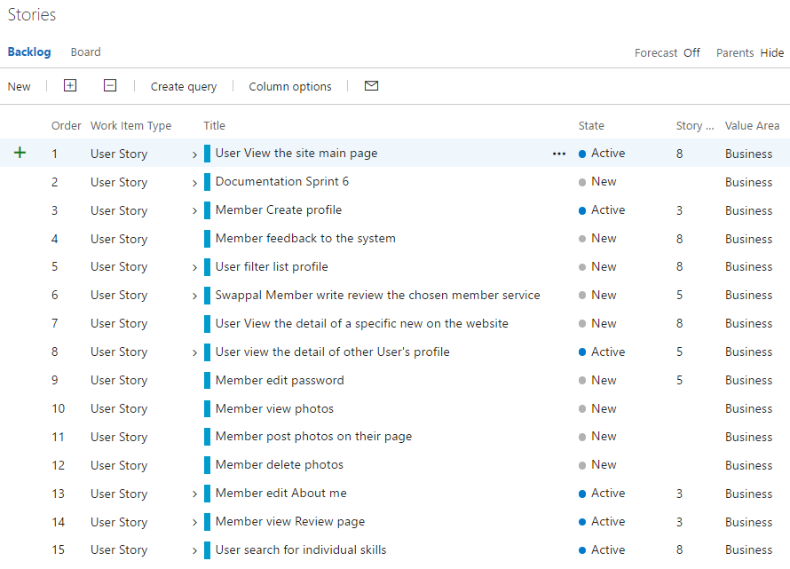
Product backlog-User stories

Slide 61
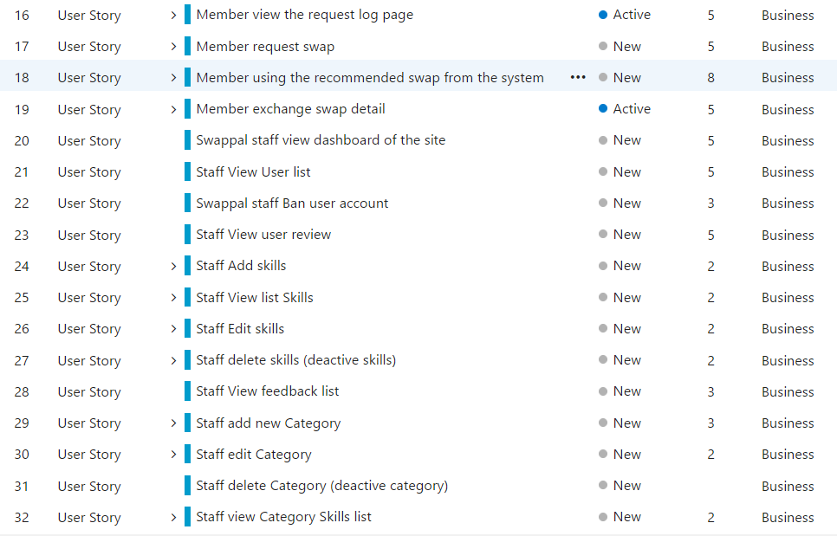
Product backlog-User stories(con’t)

Slide 62
Product development stage
Part 4.0: Design

Slide 63
Design UI

Slide 64
Product development stage
Part 4.0: Design Database schema

Slide 65
Design Database

Slide 66
Project risk

Slide 67
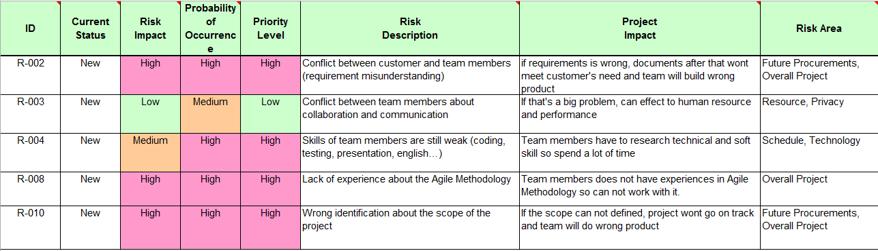
Notes:
Background: Nowadays, lots of people share and get information from each other.
We build community based on sharing new things across the world

Slide 68

Thank you for your attention!
THE END

